Slide 1
Participants, Families, & Community:
Communicating About Change
Jeannine Pavlak & Corey Smith
National Subject Matter Experts
Pennsylvania Employment First Bootcamp
May 2017

Slide 2
“Times They are a Changing”
How to communicate the new reality?
How to blame it on the system, just the right amount?
How do we communicate how we are embracing the new reality?
The Value of Work and Community Integration

Slide 3
The System Why
The ADA
Olmstead
Employment First
WIOA
The Able Act

Slide 4
“The Why”
The average family loses $700,000 in projected income supporting a person with a disability
Money is important to people trying to “lead an every day life”
New SSA Work Incentives
The Able ACT
We are not throwing people away

Slide 5
“The Why” (2)
Helping People Escape Poverty
“Does all really mean all”
Retiring with a bigger Social Security check

Slide 6
How Do People Know Us?
What are we known for in the community?
Great Employment Services?
Day Programs?
Residential Services?
Fund Raising?
Possibly rebranding employment services?

Slide 7
How is This Going to Work?
Present a plan that highlights how we are going to get better at helping people attain and maintain individualized employment
Not how we are going to quickly close programs and leave people with nothing to do

Slide 8
Identifying Your Stakeholders

Slide 9
Identifying Your Stakeholders
As a leader in your organization, you need to identify and consider all of your stakeholders.
Invested vs Impacted

Slide 10
Invested Stakeholders
Those investing resources
  Funding Sources: Government; Grants; Endowments; Donors
  Employees, whether compensated or volunteer. The best invest a lot of passion in their work.
  Partners: Suppliers, joint ventures and contracted parties who invest something in your organization. Whether it is components of your products or services that help you succeed, partners have a stake in the organization.

Slide 11
Impacted Stakeholders
Those that are impacted by your decisions and actions
  People you serve and their families
  Families of those you employ
  Community: physical and logical. Physical - community surrounding you and logical - the associations in the field- EMPLOYERS
  Social Cause: how you impact social causes creates stakeholder groups

Slide 12
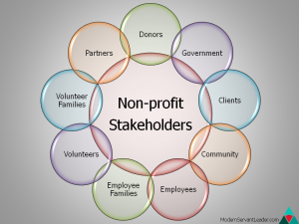
Non-Profit Stakeholders

Slide 13
Small Group Exercise
Top Three Targets:
For the purposes of your transformation efforts, who are the top three targets that you need to reach? [These are your “essential partners”]

Slide 14
Messaging Strategy

Slide 15
Creating your Messaging Strategy
The messaging strategy is how you as a leader talk to all people. The message should be consistent and transparent and used as a tool to build trust.
    Ask yourself first, What is motivating us to change?
    The message created around this must be consistent throughout the organization, including how employees communicate.

Slide 16
Creating your Messaging Strategy con’t
Message should be pre-emptive and focus on the benefits
Message should be informational and focus on facts
Message needs to be credible and decrease perception of risk

Slide 17
Communicating with Individuals and Families
We are going to get better at helping people get good jobs?
We are going to help more people get jobs?
Who is interested in getting a job?

Slide 18
Strategy For Sharing Your Message
Decide which channels will be most effective- HOW
Determine your audience and how and when they will best receive information- WHO & WHEN
Make it relevant to that stakeholder group
Anticipate concerns and questions
Seek mutual understanding and identify mutually beneficial solutions.
Focus on the future: Emphasize what can be done by sharing data and success stories

Slide 19
Strategy Options
Community Conversations
Focus Groups
Open Forums
Business Networking International

Slide 20
World Café Process
5-8 participants sit at café style tables with already established questions
Every café table has a host who remains at the table
People travel to various tables engaging in conversations lasting for about 15-20 minutes
People listen and share insights and ideas
When the first round is completed everyone (but the host) travels to a new café table
Travelers begin to synthesize their discoveries and sometimes a deeper question emerges
At the end, members share collective discoveries and insights as a whole group in a town meeting called “Harvesting”
The result is a sense of the larger whole, new possibilities for action emerge.

Slide 21
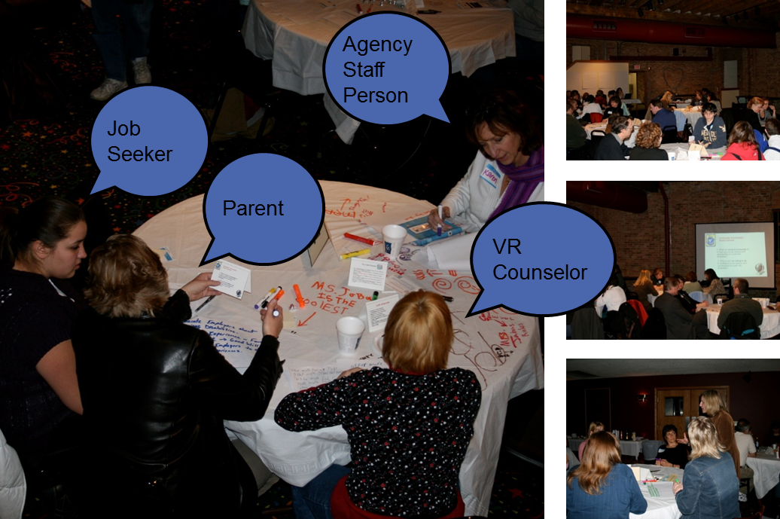
Photos

Slide 22
Why A World Cafe?
Provides a vehicle for launching community-wide efforts
Identifies new (undiscovered) allies
Uncovers untapped resources and opportunities
Focuses on local assets and community pride, rather than deficits
Generates creative ideas from a broad spectrum of community members on ways to overcome barriers, begin new initiatives and develop partnerships
Develops a list of “first steps” that moves participants from discussion to action

Slide 23
Why A Focus Group
Gather opinions, beliefs, and attitudes about issues of interest to your organization
Test your assumptions
Encourage discussion about a particular topic
Build excitement from a combination of participants' comments
Provide an opportunity for others to learn more about a topic or issue.

Slide 24
Why A Public Forum
Give people of diverse backgrounds a chance to express their views
As a first step toward understanding the community's needs and resources
They can offer your group valuable insights into the community
They can provide a database for guiding and explaining actions
They can help link your group with people who are able and willing to help
They can provide the group with feedback

Slide 25
Communicating the Change

Slide 26
Communication with Individuals and Families
Explain the changing landscape and Employment First legislation which may have prompted a change
Explain why community integration and employment is the better choice
Allow individuals and families to express their hopes and fears
Describe what employment services will look like – Be clear about what will and won’t change- explain how this is going to work
Keep open and regular communication

Slide 27
Strategies for Individuals and Families
Introduce families to others whose child is employed in the community
Start a peer support group
Share success stories often
Begin Person Centered Planning and Futures Planning, if not already being done.

Slide 28
Communicating with Staff
Why?
Because it is the right thing to do!!
The system made me do it!!!
New EXCITING opportunities for those who are interested
How will this effect my job?

Slide 29
Employer Engagement
What do You Need To know?

Slide 30


Two Worlds
Human Services
Business

Slide 31
Employer Engagement Strategies
Know your networks and the networks of those around you-Who do you already have relationships with?
How will your staff approach employers-Prepare them
Employers want to hear their ROI
Consider developing an ”Active Employer Council”

Slide 32
Developing an Active Employer Council
Use your Board of Directors to help find small businesses
Use an agencies list of accounts payable
Invite small businesses that you work with now to connect with other businesses
Help these small businesses connect and expand commerce.

Slide 33
What Do Employers Say About Customized Employment
Saved them money
Improved morale
More Efficient
Helped meet goals
“Employees they could count on”

Slide 34

Final Thoughts
Begin Planning early
Actively involve families and other stakeholders
Engage busine
ss community
Capitalize on Community Involvement
Draw in other formal support systems and agencies

Slide 35
Small Group Exercise: You Pick
                Share a challenging communication issue you have had with parents/family members and clients. What feedback can the group provide?
                How can we best listen to our stakeholders during the transformation process?
How can we empower these stakeholders as part of the transformation process?
How can we generate excitement and enthusiasm?

Slide 36
Contact Information
Jeannine Pavlak
jeannine.pavlak@nebaworks.com
Corey Smith
Senior Consultant, Griffin-Hammis Associates Inc.
csmith@griffinhammis.com

